Slide 1
LLMs & ADK Agents
Architecting the scalable, autonomous enterprise workflows.

Slide 2
THE PARADIGM SHIFT
Static to Autonomous
Traditional Software
Agentic Workflows
Pre-defined logic pathways.
Dynamic intent reasoning.
Fails on unexpected edge cases.
Self-correcting execution plans.
Rigid API integrations.
Autonomous tool calling.
LLMs & ADK Agents
Slide 2

Slide 3



FRAMEWORK DESIGN
Google ADK Pillars
Developer Native
Stateful Routing
Production Security
Python, Go, and JS SDKs.
Graph-based orchestration logic.
Deterministic runtime guardrails.
LLMs & ADK Agents
Slide 3

Slide 4


Execution Pipeline
Ingest
Route
Execute
Synthesize
Parse user intent.
Select specialized agent.
Call external APIs.
Return validated output.
LLMs & ADK Agents
Slide 4

Slide 5



ENTERPRISE TRUST
Zero-Trust Sandbox
Semantic Firewall
Blocks malicious prompt injections.
Isolated Execution
Code runs in secure gVisor kernels.
Cryptographic Verification
Outputs signed before database entry.
LLMs & ADK Agents
Slide 5

Slide 6
40%
Reduction in hallucination rates.
Driven by deterministic state management.
LLMs & ADK Agents
Slide 6

Slide 7

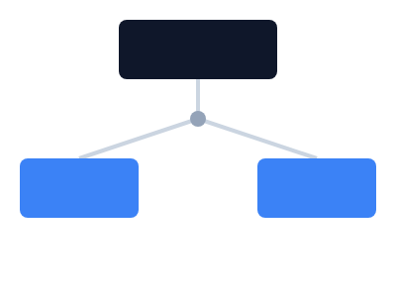
ORCHESTRATION
Multi-Agent Routing
Supervisor delegates specialized tasks.
Worker agents execute concurrently.
State preserved across boundaries.
LLMs & ADK Agents
Slide 7

Slide 8
import { Agent } from 'google-adk';
IMPLEMENTATION
const supportAgent = new Agent({
Native Developer Experience
role: 'Tier 1 Resolution',
tools: [dbQuery, ticketAPI],
stateManager: redisStore
});
Unified APIs across modern languages.
await supportAgent.execute(intent);
LLMs & ADK Agents
Slide 8

Slide 9
Enterprise Applications
DevOps Automation
Data Engineering
Customer Support
Autonomous infrastructure remediation.
Automated pipeline synthesis.
Tier-2 resolution engines.
LLMs & ADK Agents
Slide 9

Slide 10
Ready for Production.
Deploy the autonomous enterprise today.
npm install google-adk

